Slide 1
Exploring the Cosmos: An Educational Website on Space and Space Technologies
HACKOUT’24 : 9th August – 11th August

Slide 2
Members:-
Dhruvil Patel (Leader)
dhruvil1405patel@gmail.com
Aarya Shah
aaryashah1010@gmail.com
Dhruv Patel
dhruvjp2005@gmail.com
Khush Patel
khush2236@gmail.com

Slide 3
Introduction
The Need for Space Education: | Despite the growing interest in space, accessible, high-quality educational resources on space and space technologies are limited.
Gap in Resources: | Current educational materials are often fragmented, outdated, or too complex for younger audiences.
Inspiration: | With space exploration becoming more prominent (e.g., Mars missions, space tourism), there’s a need for a platform that educates and inspires the next generation.

Slide 4
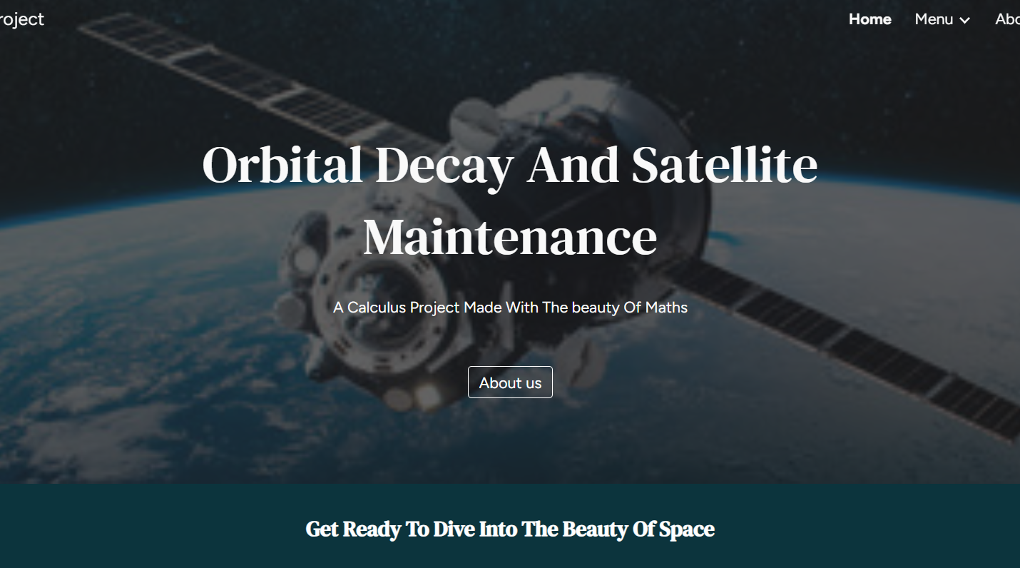
Project Overview:
Purpose : The platform is designed to be a comprehensive educational tool that covers various aspects of space and space technologies.
Target Audience : Students, educators, space enthusiasts, and the general public.
Mission Statement : “To make space education accessible, engaging, and inspiring for learners of all ages.”

Slide 5
Key Sections
Explore the Universe
Space Technologies
1
2
Learning Modules
Space Careers
3
4
Interactive content about the solar system, galaxies, and space phenomena.
In-depth sections on satellites, spacecraft, rockets, and space stations.
Tailored content for different learning levels (beginner, intermediate, advanced).
Insights into various careers in the space industry.

Slide 6
Educational Impact
Learning Enhancement
Engaging Content
Supporting STEM
Interactive elements and multimedia content help keep learners engaged and improve retention.
The website supports formal and informal learning by offering structured modules and resources.
Encourages interest in STEM (Science, Technology, Engineering, Mathematics) fields, critical for future innovation.

Slide 7
Social Impact
Inspiring Future Generations
Global Reach
Community Engagement
Inclusivity
By providing easy access to space knowledge, the website aims to inspire the next generation of scientists, engineers, and explorers.
The website can be accessed globally, breaking down geographical barriers to space education.
Accessible to diverse populations, including multilingual content and resources for those with disabilities.
Features like forums and user contributions foster a community of space enthusiasts, educators, and learners.

Slide 8
Thanks!
Please keep this slide for attribution

